Slide 1



When Restorative Practice Marries Family Therapy: a dynamic blended family
Jennifer Bowen and Anne Martin
May 1, 2018
Notes:
Jennifer

Slide 2
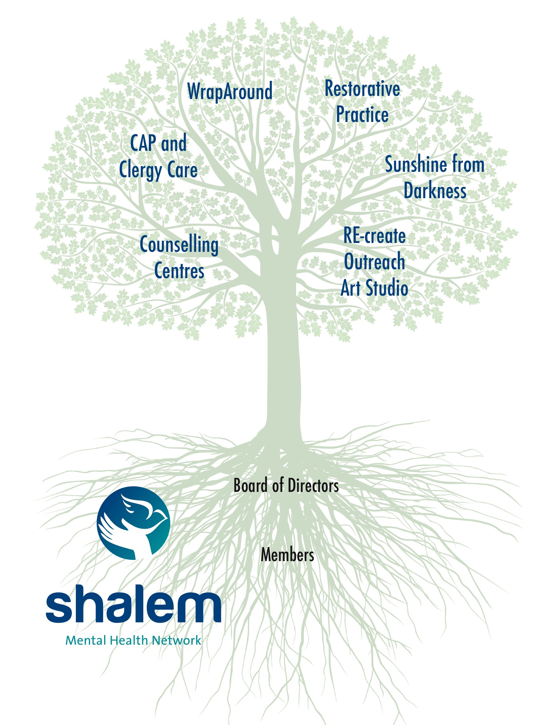
Notes:
Jennifer

Slide 3

Purpose of workshop
Part 1:
How collaboration developed
Service development & delivery
Restorative Practices Used Clinically
Differences between Counseling Clinic referrals & other restorative conferences
Therapeutic models & assumptions congruent with Restorative Practice
Notes:
Anne

Slide 4
Purpose of workshop
Part 2:
Putting Restorative Practice into practice
Restorative conferences
2 cases studies
Notes:
Anne

Slide 5
Purpose of workshop
We are sharing this content in the spirit of development – the program is a work in progress.
Happy for your input and suggestions.
Notes:
Anne

Slide 6
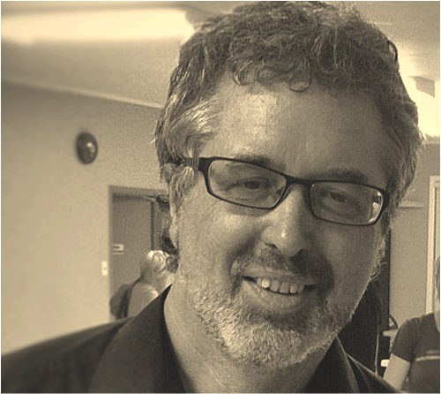
How collaboration developed
Mark VanderVennen,
Executive Director
Notes:
Jennifer

Slide 7
Service Development
There are 2 ways we deliver services to families:
Counseling clinic referrals, using RP, meeting with a therapist
Restorative Practice referrals, without therapist involvement
Notes:
JEnnifer

Slide 8
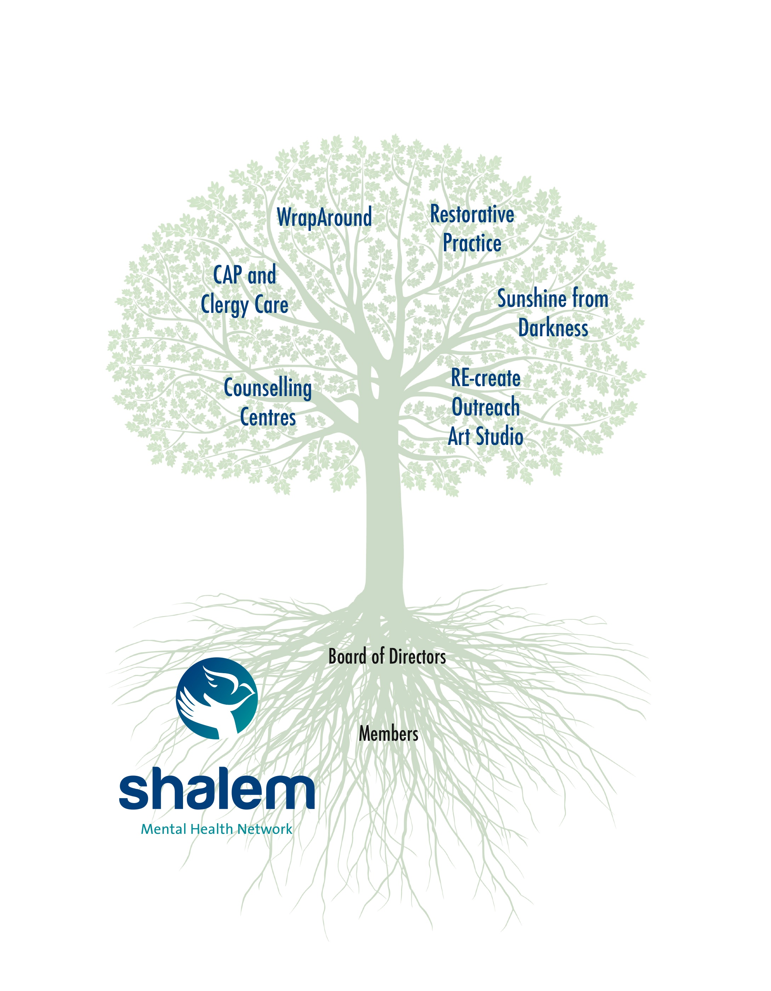
Notes:
Jennifer

Slide 9
Service Delivery
For the purpose of our presentation, we’re
focusing on the therapeutic setting.
Notes:
Jennifer

Slide 10

Restorative Practices Used Clinically
Restorative Framework principals:
  Compass of shame
  Quadrants: Relationship styles-leadership styles
  Restorative questions
  Non-punitive posture/attitude
Notes:
Anne

Slide 11
Restorative Practices Used Clinically
Continuum of practice
    Affective statements
    Information conversations using the restorative questions
    Use of a talking piece (helpful for levels of development/abilities)
    Formal restorative conferences
Notes:
Anne

Slide 12
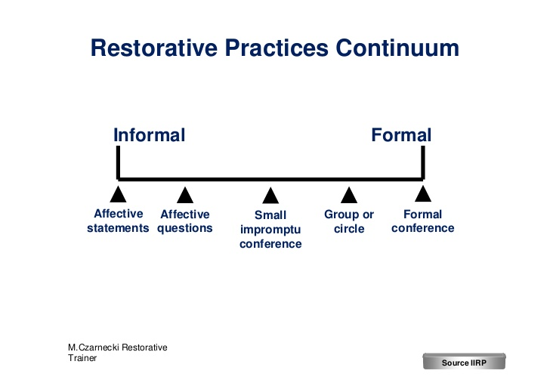
Notes:
Anne

Slide 13
Differences between Counseling Clinic referrals & other restorative conferences
Notes:
Jennifer

Slide 14
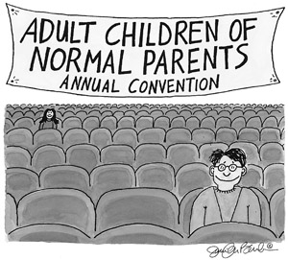
Notes:
Jennifer

Slide 15
Family relationships are permanent in nature, even if estranged.
Primary attachment figures are powerful.
Family relationships can be complex.
The Nature of Families
Notes:
Jennifer

Slide 16
After community conferences participants usually don’t go home together, and often don’t have to see other conference participants if they choose not to.
Family members sometimes live together or visit regularly. Decompressing afterwards can be difficult.
The Nature of Families
Notes:
Jennifer

Slide 17
Holidays, weddings, funerals, wills, family businesses
Impetus for a Conference
Notes:
Jennifer

Slide 18
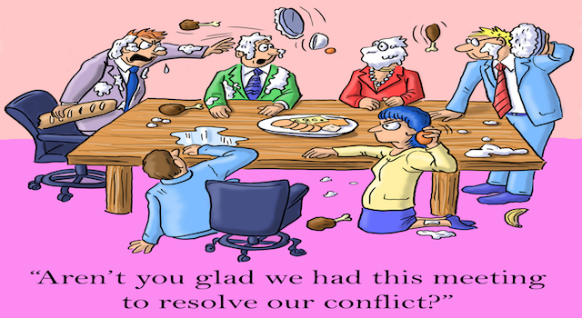
Notes:
Jennifer

Slide 19
Often have escalated emotions.
On average emotions are more heightened. Years of conflict often fuel the issue.
Emotional Highs
Notes:
Jennifer

Slide 20
It can be much harder to stay focused on one incident when participants have had a lifetime of conflict.
Other issues can easily surface.
Conference focus
Notes:
Anne

Slide 21
Pacing can be difficult. Families who are escalated may urge facilitators to move the process forward quickly.
It can be hard to resist the urgency that families might present with.
Families are often looking for a quick fix especially when they sense hope and want relationships restored immediately.
Pacing
Notes:
Anne

Slide 22
Therapeutic models & assumptions congruent with Restorative Practice
Notes:
Anne

Slide 23
Attachment Theory
Attachment Theory: John Bowlby
Dyadic Developmental Psychotherapy(DDP): Dan Hughes
Emotionally Focused Therapy (EFT):
Sue Johnson
Notes:
Jennifer

Slide 24

Notes:
Jennifer

Slide 25
Other Models
Emotionally Focused Therapy (EFT):
Les Greenberg
Narrative Therapy: Michael White, Alan Jenkins
Solution Focused Therapy: Steve de Shazer, Insoo Kim Berg
Notes:
Jennifer

Slide 26
Other Models
Structural Therapy: Salvador Minuchin
Intergenerational Therapy: Murray Bowen
Notes:
Jennifer

Slide 27

Notes:
Jennifer

Slide 28
What therapy and RP have in common:
Notes:
Anne

Slide 29
What therapy and RP have in common:
Both create a safe space
Both engineer authentic conversation
Both hope to resist vilification, and seek restoration (as much as possible)
Both work to facilitate constructive, corrective emotional experience through relationship
Notes:
Anne

Slide 30
Where therapy and RP are different
Clients may have different expectations and goals
Training/goals of facilitators/therapists
Therapy may be longer than RP process
Different set of ethical guidelines, governing bodies, language used
Notes:
Anne

Slide 31
It is essential in this work to be clear with clients what service they are receiving – when is it therapy, when is it RP and when is it both.
We also work to clarify roles.
Notes:
Anne

Slide 32
Part 2: Putting RP into practice
Notes:
Jennifer

Slide 33
Part 2: Putting RP into practice
Restorative tools: quadrants, talking stick, restorative questions, compass of shame
35-45 cases (estimate) from 2014-2018
Notes:
Jennifer: Give some description of how conferences have gone. Number we’ve offered.

Slide 34
Part 2: Putting RP into practice
Restorative conferences
Follow RP protocol of pre-conference meetings, attendees, safe space, followed by breaking bread
Notes:
Jennifer
Give some description of how conferences have gone. Number we’ve offered.

Slide 35
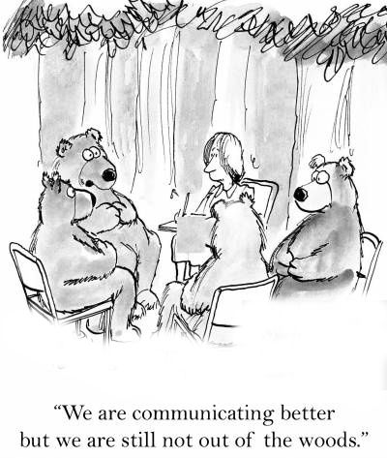
Notes:
Jennifer

Slide 36
Restorative Conferences Recommendations
Therapist should attend:
  For support: their main role
  To highlight helpful elements in the conversation that support the process
  Perhaps help participants understand the client’s experience more deeply
  To support other family members as appropriate
Notes:
Jennifer

Slide 37
Restorative Conferences: Recommendations
Therapist should attend:
  To offer clarity within the conversation
  To offer validation as appropriate
  To participate in the agreement, as appropriate
  To be able to share the circle experience with the client, and bring that forward in future work
  To strengthen the Restorative Team’s capacity for delivering services well
Notes:
Jennifer

Slide 38
Pre-conference work
Because of the complexity of family relationships, never take pre-conference meetings for granted.
Always do extensive pre-work.
Families may be minimizing their distress.
Conferences with more preparation go far better.
Notes:
Anne

Slide 39
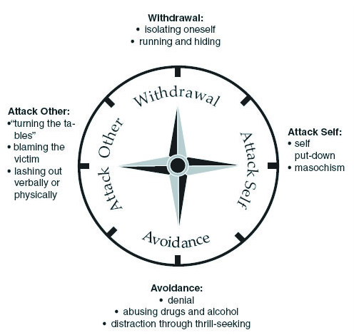
Notes:
Anne

Slide 40
Talking about RP with families
Emphasize process over conference
Pre-conference meetings can be as important as the conference. De-emphasizing the conference can help family members pace themselves.
With the focus off of the conference, there is less chance for blame if the therapist and facilitator decide that a conference is not appropriate
Restorative READINESS
Notes:
Jennifer

Slide 41
Pre-circle process/questions:
Case by case assessment. We recommend flexibility and catering the assessment process to each individual case.
We also recommend a 2 stage model for assessment – meeting both with the therapist and with the facilitator.
Notes:
Jennifer

Slide 42
Helpful Questions:
What’s the right conversation for the conference? This Is a central issue in preparing for conference .
What’s the focus and who should be part of this conversation? (it may be more helpful for fewer people to be present at first)
Track the power dynamic in the family. Who has power? Who doesn’t?
Is the client willing to take responsibility for their part in the breakdown of the relationship?
Does the client want things to get better?
Is the client willing to hear what other people have to say?
What do they need for this to be a safe space?
Notes:
Jennifer

Slide 43
Expectations/challenge

Slide 44
Helpful Questions 2:
How will they react if they hear something they don’t like? Are they open to hearing things they don’t like to hear about themselves? How do they imagine themselves responding?
Are there members of the family they can hear better than others?
How has things gone in the past when they’ve tried to talk about issues? How do they expect to feel?
Do they need to do some work on themselves to be ready to hear things that are painful? Are they ready to be open/flexible?
Do they need a safety plan for the conference if they lose their temper or are frightened?
Therapist gets permission to share content with the facilitator.
Notes:
Jennifer

Slide 45
Counter-indicators: When is a restorative process not suitable for a family?
Stage 4-5 likely not suitable (see handout)
If members of the family are unable to focus on the issue at hand
If there is an active addiction, or a member arrives intoxicated, they can’t participate, and the conference won’t be appropriate.
if there is active violence, or if one member reports being afraid of or threatened by another family member
Notes:
Anne

Slide 46
Predictors of a good outcome:
Thinking about family systems, and the role of the parents in the hierarchy of functioning, parents of the system need to be able to:
Hear stories
Generate empathy
Engage in a new way of thinking
Be non-reactive
Notes:
Anne

Slide 47
Predictors of a good outcome:
The circle will likely not go well if the parents are:
Not able to stay grounded
Not able to hear what’s being said without falling apart
Not able to stay self reflective and open to new information
Notes:
Anne

Slide 48
Predictors of a good outcome:
It is critical to have a strong/effective relationship between the facilitator and the therapist, with clear expectations of roles, and clear communication.
Notes:
Anne

Slide 49
Case Study #1
Supporting a conversation within a large adult family after the disclosure of historical abuse by one sibling of another.
Facilitating expressions of concern, empathy, and wishes to move forward.
Notes:
Jennifer

Slide 50
Case Study #2
Adult child with unexpected mixed-race pregnancy causes significant conflict in a conservative family when she moves home for economic reasons.
Mom initiates circle, with the goal of discussing how to live together moving forward.
Notes:
Anne

Slide 51
Future Hopes
Booklet for families on what to expect, process, roles, costs
Website info
Outcome measures
Article
Notes:
Anne

Slide 52
Anne Martin, Director of Restorative Practices
Jennifer Bowen, Clinical Director office@shalemnetwork.org
866-347-0041
Thank you!

